Slide 1
Optimal Clustering Techniques: Hierarchical and k-means
Name: Yash Wadhwa
NUID: 002778382

Slide 2
INTRODUCTION
In the world of machine learning clustering techniques, specifically K Means and Hierarchical Clustering. These algorithms play a crucial role in analyzing and grouping similar data points in a dataset, making it easier to draw meaningful insights and make informed decisions.

Slide 3
Hierarchical clustering
Definition: Hierarchical Clustering is a method of clustering data points into groups, with the hierarchy represented as a tree-like diagram known as a dendrogram.
Algorithm: The algorithm can be performed in two ways, Agglomerative and Divisive, both of which start with every data point as its own cluster, and then either combine or divide clusters until the desired number of clusters is reached.
Advantages: Hierarchical Clustering can handle non-spherical shapes and different sized clusters. The dendrogram provides a visual representation of the clustering hierarchy, making it easier to understand the results.
Limitations: Hierarchical Clustering is computationally expensive and requires a lot of memory, making it difficult to use with large datasets. The choice of the number of clusters can also be subjective and may require multiple iterations to get optimal results.

Slide 4
Technical Approach
Loading: Load "Play.xlsx" dataset into pandas data frame
Preprocessing: Before applying any clustering algorithms, preprocess data (clean, handle missing values, normalize and scale)
Model Selection: Use Agglomerative Clustering from scikit-learn
Setting the linkage method and distance metric: Set linkage method to single, distance metric to euclidean, number of clusters to 2
Fitting the model: Fit preprocessed data to the model
Evaluation: Evaluate performance using confusion matrix and classification report from scikit-learn

Slide 5
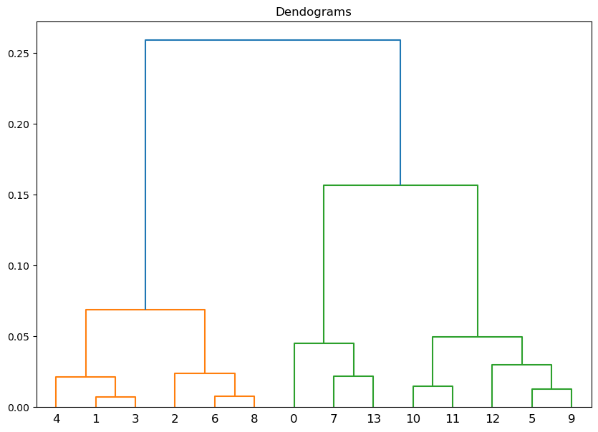
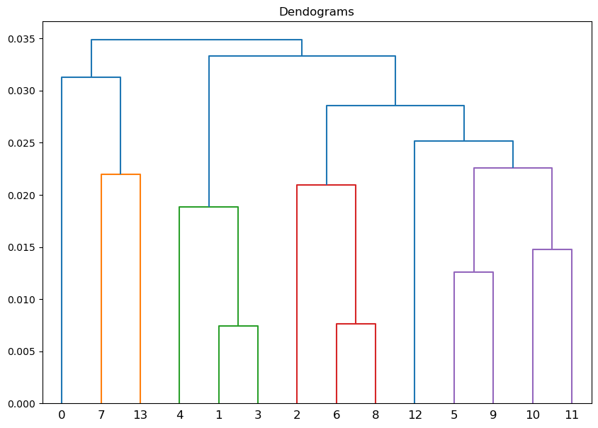
Output:
Dendograms: Ward, Single, Complete, Average, Weighted and Centroid (executed in the notebook).
Ward
Single

Slide 6
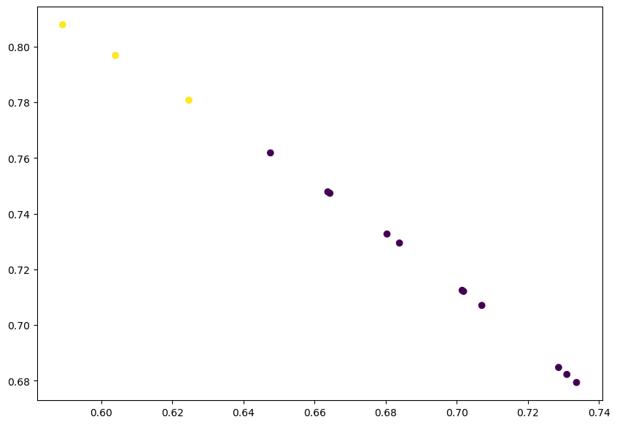
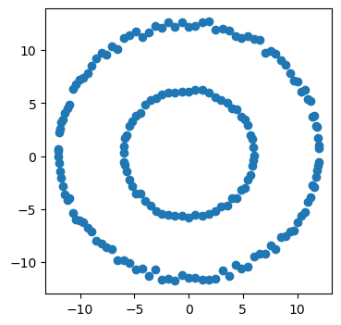
Output:
Scatter Plot: Representing clusters formed between Temperature and Humidity
From the data generated by the help of concentric circles by also adding some random noise.

Slide 7
K-Means Clustering:
Definition: K Means is a centroid-based unsupervised learning algorithm that partitions a dataset into K clusters.
Centroid Calculation: The algorithm calculates the centroid of each cluster by taking the mean of the data points in that cluster.
Iterative Process: The algorithm continues to iterate and update the centroid until it reaches convergence, where the centroid remains unchanged.
Applications: K Means is commonly used in customer segmentation, market research, and image processing.

Slide 8
Technical approach:
Load the dataset using pd.read_excel and store it in df.
Preprocess the data by mapping the values in the "Decision" column to integers, one-hot encoding the categorical columns "Outlook" and "Windy" and normalizing the data.
Determine the optimal number of clusters using the elbow method.
Fit a k-means clustering model with the optimal number of clusters to the data and add the cluster labels to the dataframe.
Evaluate the performance of the k-means model using a confusion matrix and a classification report.

Slide 9
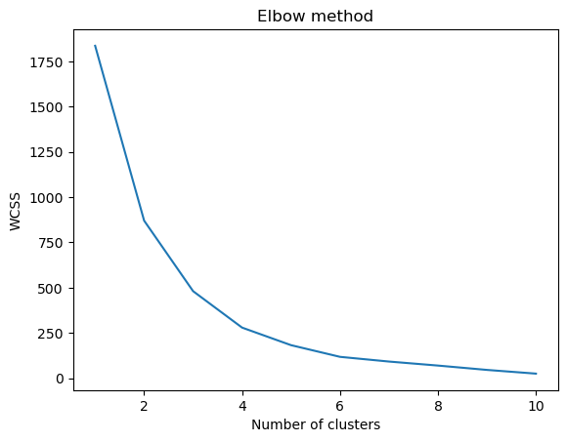
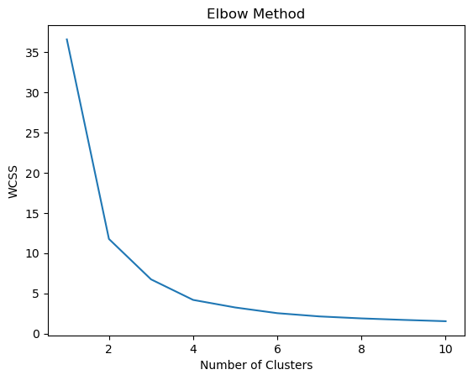
Output:
Elbow Method:
Play Dataset
Boston Housing Dataset

Slide 10
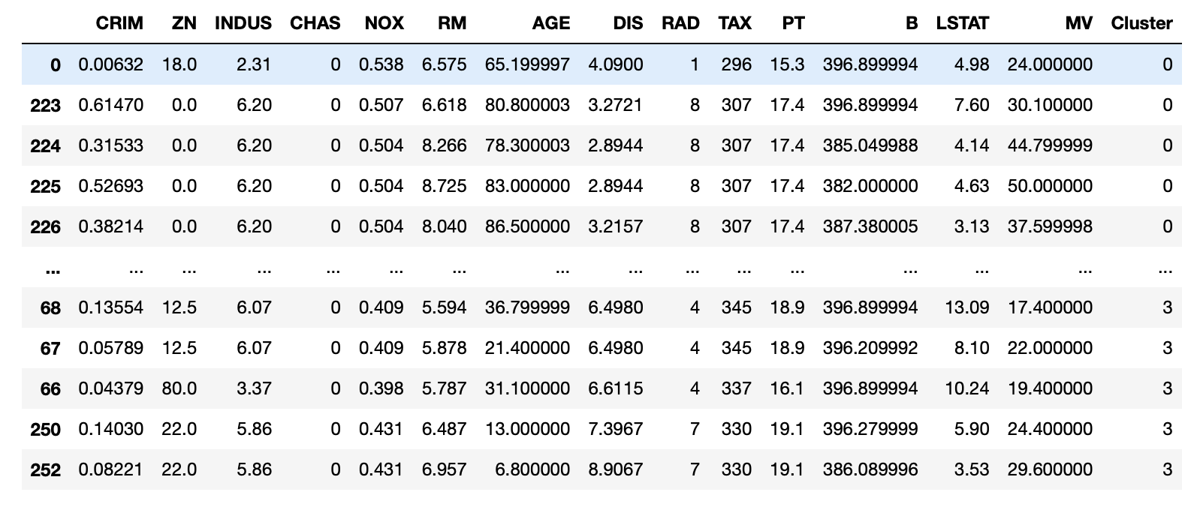
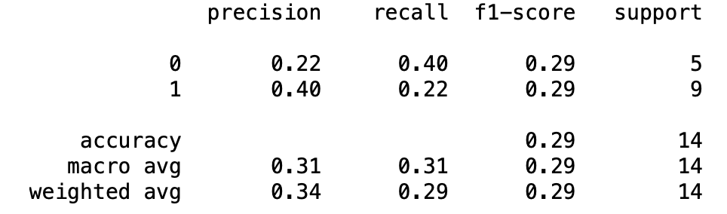
Output:
Play Dataset:
Boston Housing Dataset:
Performance Report
Clusters formed via the Elbow Method

Slide 11
Conclusion
Successful clustering: The code successfully performed k-means and hierarchical clustering on the dataset, grouping the data into two distinct clusters based on their attributes.
Visualization: Visualized the results using dendograms, scatter plot, concentric circles and elbow method plot.
Performance evaluation: The performance of the model was evaluated using the confusion matrix and classification report metrics.
Insights and future work: The results of this analysis can be used to gain insights into the relationships between different attributes in the data, and to make informed decisions.
At last, K-Means algorithm came out to be better in terms of performance and gainful insights.

Slide 12
Thank you!

